Slide 1
Timeseries: Commodity Problem
Under the Guidance of:
Mr Srikar Muppidi
Great Learning
Bangalore
Presented by:
Kevin Rajkumar - DSEFTBNOV18008
Sukalp Shivam - DSEFTBNOV18015
Manas Ghosh - DSEFTBNOV18011
Gaurav Garhewal - DSEFTBNOV18006

Slide 2
Objective
The objective is to study the monthly trend of most important commodities and then forecast for the next 12 months in each region of India.

Slide 3
Problem Definition
Commodities like Onion, Rice, Dal, etc have a year –round production
Determining the price of such commodities is a challenge as many factors are involved in defining the price from economic factor to weather conditions
We tried to analyse the trend attached to such commodities and forecasted the best values for next 12 months
The curves in these timeseries are not because of its seasonality but fluctuation in price due to external factors
It is important to determine the price because you can warehouse the commodity for which price is increasing or you can hold off from bulk purchase if price is deteriorating

Slide 4
Suggested Solution- Algorithms
Timeseries Modelling
Decomposition
Simple Exponential Smoothing
Holts Model
Regression (auto)
ARIMA model
Holts-Winter Model
SARIMA model

Slide 5
Dataset Description
Columns | Description
Date | The date on which particular observation has been taken
Center | Name of the city where observation is based
Region | Center Converges into Five regions
Commodity | Name of the product
Price per Kg | In INR, the per kilogram price of the commodity
Country | Name of the country

Slide 6
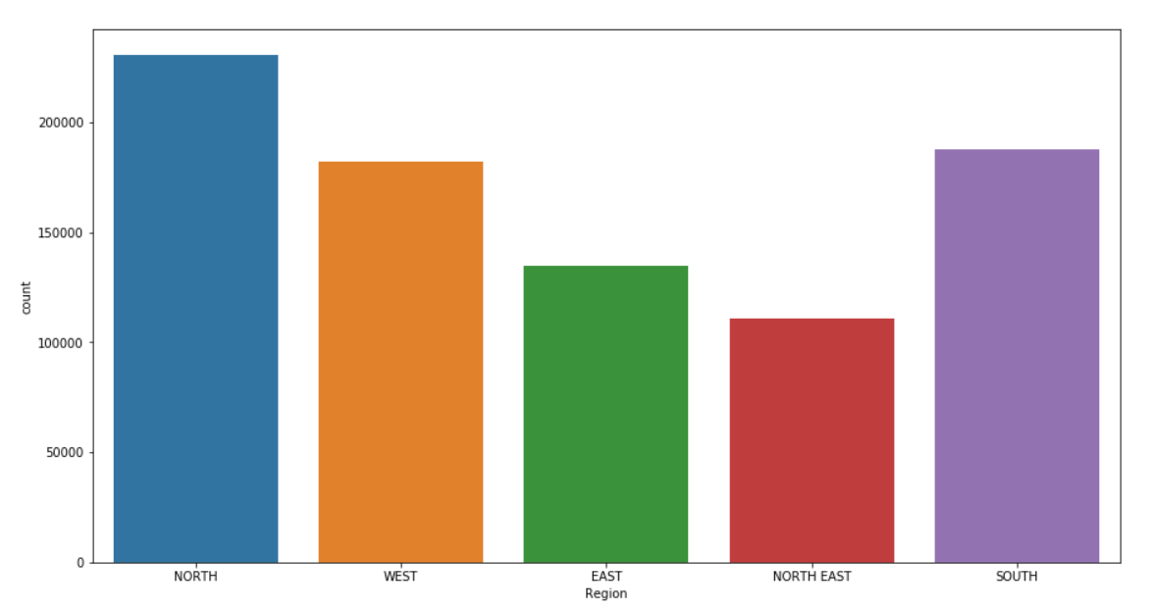
Exploratory Data Analytics
The number of observations taken for north region is higher in comparison to other regions and North-east region has lowest number of count

Slide 7
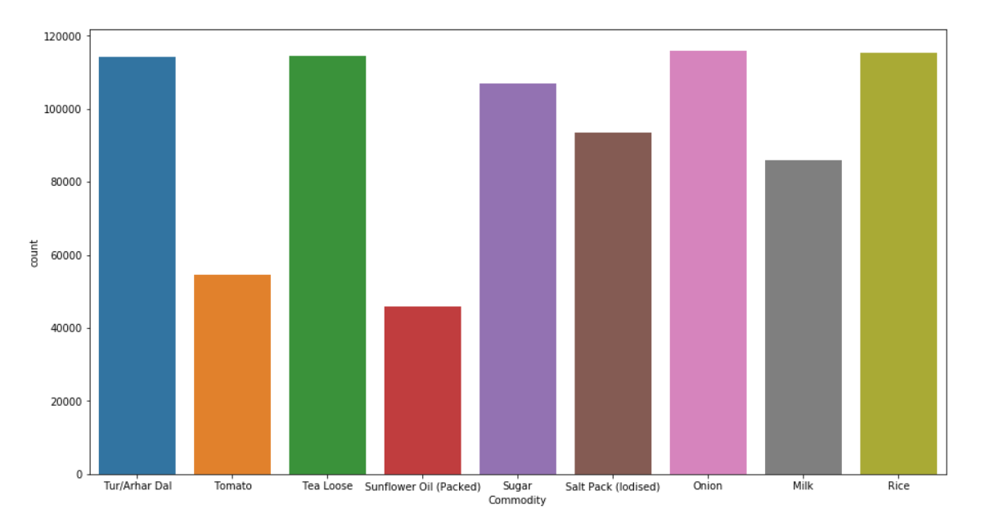
Exploratory Data Analytics
Out of 9 commodities, the five most important commodities based on number of observations are chosen and they are listed in order as below:
Tur/Arhar Dal
Tea Loose
Sugar
Onion
Rice

Slide 8
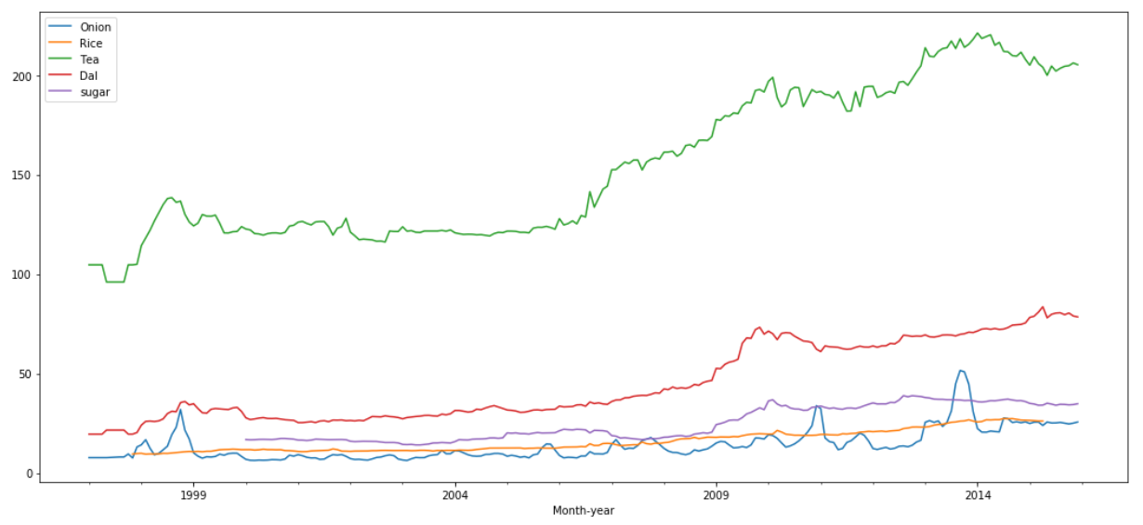
Exploratory Data Analytics
These are the five important commodity timeseries for Northern Region
No visible seasonality is present
There are fluctuations in the price of all the important commodities
The price is increasing over the years for Dal, Rice and Sugar, there are few fluctuations in the timeseries but no big fluctuations that could affect the prediction values.

Slide 9
Process Flow Chart
Import the csv file
Create a timeindex
Create month-year column
Pickup a region and commodity
Group the dataframe by month-year
Re-index the df using full time period
Use proper method to fill null values
Do the train-test split
Train all models using train dataset
Evaluate models using test dataset
Finalize the best model
Predict for next 12 months

Slide 10
Algorithms- Pros and Cons
Algorithms | Pros | Cons
Simple Exponential Smoothing | Work best with residuals | Do not consider trend and seasonality
Holt’s Linear Model | Work best with residual and trend | Do not consider seasonality in the data
Holts-Winter model | Work best with residual, trend and seasonality | Find patterns in fluctuation, if no actual seasonality
ARIMA Model | Better understand the time-series pattern | Capture only linear relationship
SARIMA Model | Have AR, MA terms for seasonality | Give bad values if seasonality not present

Slide 11
Model Evaluation
MAPE | Tur/Arhar Dal | Tea Loose | Sugar | Onion | Rice
Simple Exponential | 7.46% | 2.4% | 2.60% | 7.48% | 10.38%
Holt’s Linear Model | 1.58% | 1.12% | 1.53% | 16.43% | 2.59%
Holt-Winter Model | 5.35% | 2.37% | 2.58% | 7.54% | 9.76%
ARIMA model | 3.59% | 7.58% | 5.61% | 43.99% | 6.15%
SARIMA model | 2.92% | 8.03% | 7.56% | 18.53% | 5.01%
RMSE | Tur/Arhar Dal | Tea Loose | Sugar | Onion | Rice
Simple Exponential | 6.87 | 6.08 | 1.10 | 2.01 | 2.05
Holt’s Linear Model | 1.81 | 2.86 | 0.68 | 4.97 | 1.02
Holt-Winter Model | 4.94 | 6.17 | 1.01 | 2.06 | 1.61
ARIMA model | 3.62 | 18.15 | 2.47 | 11.4 | 1.08
SARIMA model | 3.18 | 19.48 | 0.89 | 5.4 | 1.36

Slide 12
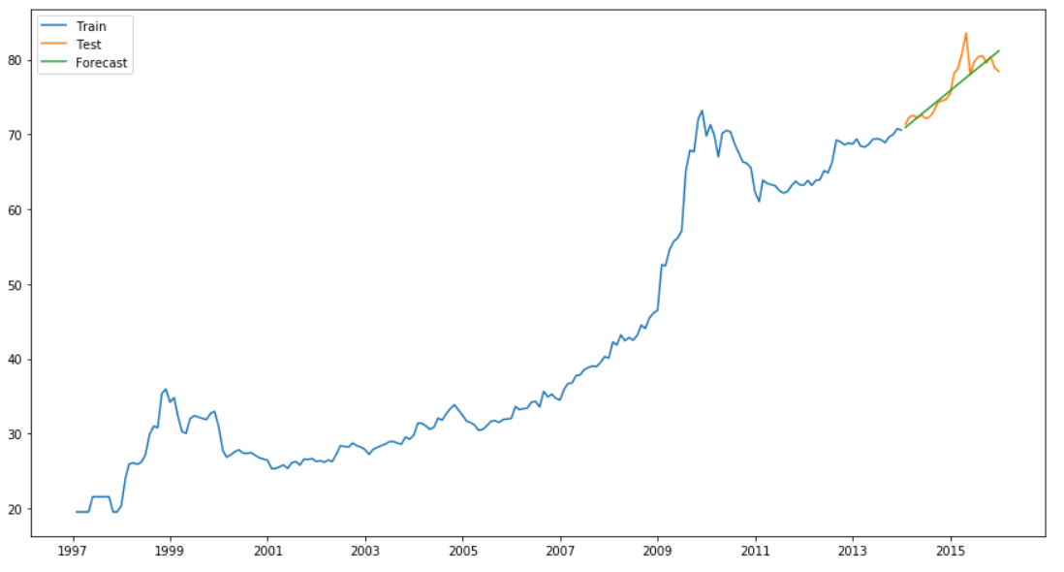
Best Model- Tur/Arhar Dal
MAPE | 1.58%
RMSE | 1.81

Slide 13
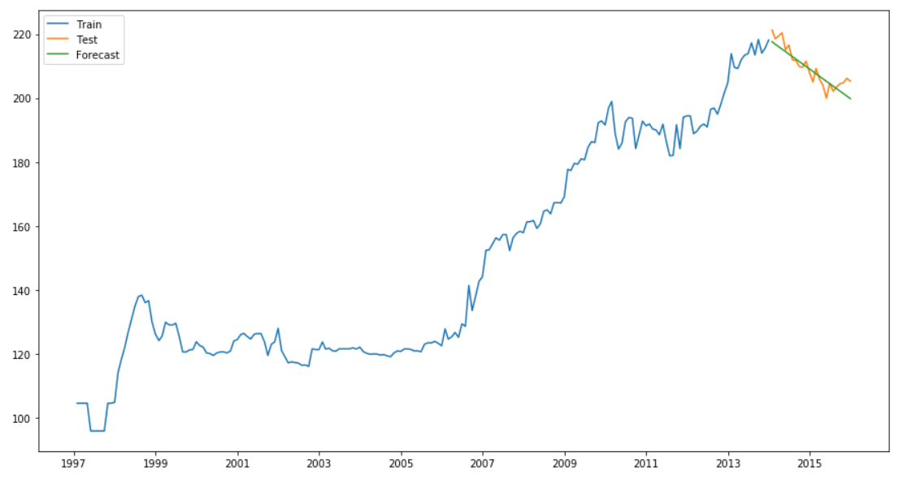
Best Model- Tea Loose
MAPE | 1.12%
RMSE | 2.86

Slide 14
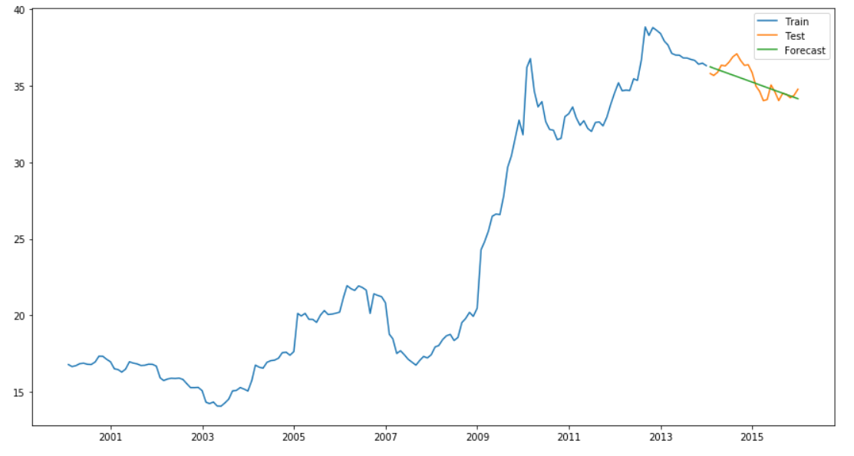
Best Model- Sugar
MAPE | 1.53%
RMSE | 0.68

Slide 15
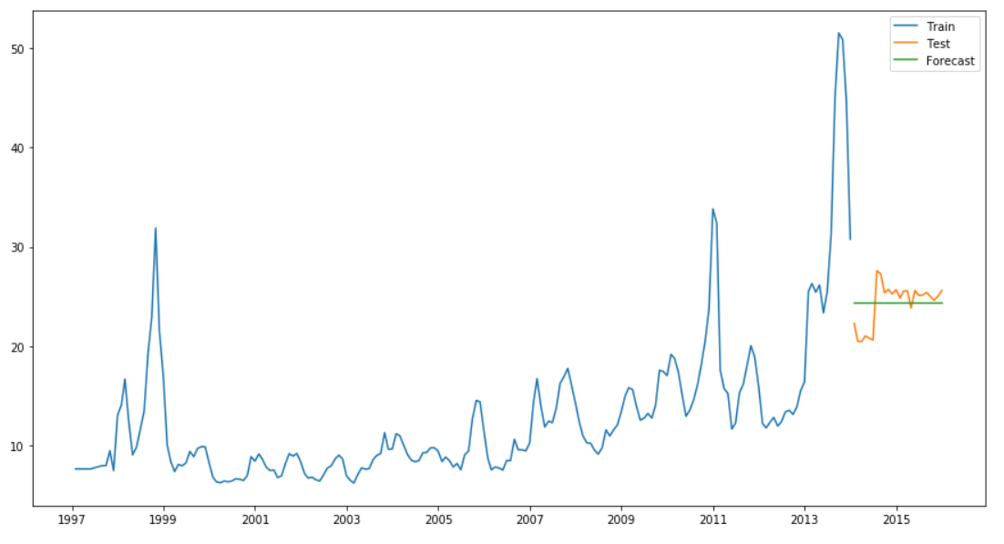
Best Model- Onion
MAPE | 7.48%
RMSE | 2.01

Slide 16
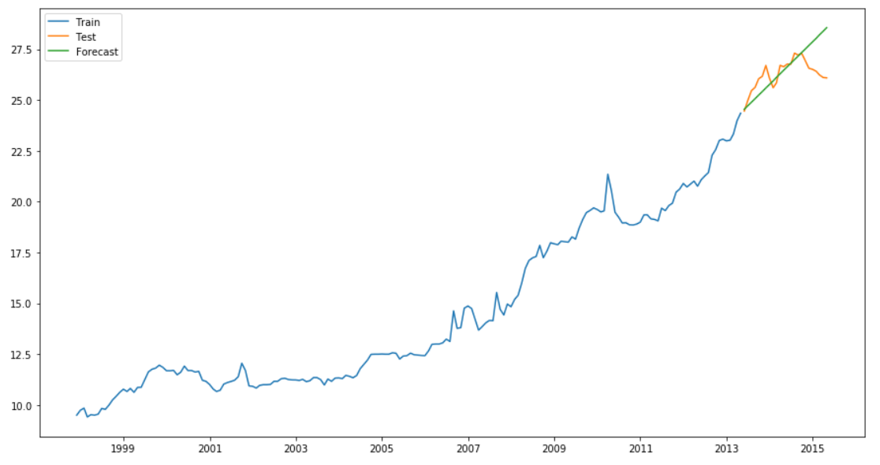
Best Model- Rice
MAPE | 2.59%
RMSE | 1.02

Slide 17
Results
2016 | Tur/Arhar Dal | Tea Loose | Sugar | Onion | 2015-16 | Rice
Jan | 78.1554 | 205.4352 | 34.92314 | 24.58021 | May | 27.57408
Feb | 77.44372 | 206.5954 | 35.1815 | 24.58021 | June | 27.6904
March | 76.73204 | 207.7555 | 35.43985 | 24.58021 | July | 27.80672
April | 76.02036 | 208.9157 | 35.69821 | 24.58021 | Aug | 27.92304
May | 75.30867 | 210.0759 | 35.95657 | 24.58021 | Sep | 28.03936
June | 74.59699 | 211.236 | 36.21493 | 24.58021 | Oct | 28.15568
July | 73.88531 | 212.3962 | 36.47329 | 24.58021 | Nov | 28.272
Aug | 73.17363 | 213.5563 | 36.73165 | 24.58021 | Dec | 28.38833
Sep | 72.46195 | 214.7165 | 36.99001 | 24.58021 | Jan | 28.50465
Oct | 71.75027 | 215.8767 | 37.24837 | 24.58021 | Feb | 28.62097
Nov | 71.03859 | 217.0368 | 37.50673 | 24.58021 | March | 28.73729
Dec | 70.32691 | 218.197 | 37.76509 | 24.58021 | April | 28.85361

Slide 18
Conclusions
The price of Tur/Arhar Dal is expected to fall in the recent future so it is better not to buy this commodity in bulk
Tea Loose price is expected to increase in next 12 months. The rate of this increasing trend is almost 1 Rs per month per Kg. Tea Loose has a good shelf life, so you can warehouse this commodity and sell in the higher rate next month.
Sugar price has not big trend in its historical data, the increase is also pretty much linear with the small slope. If you are in business of Sugar, it will give you small but consistent growth
Onion has a huge fluctuation in its timeseries, even though the series is stationary but fluctuations are not seasonal, we can call them cyclic but it is impossible to predict exact happening of those fluctuations in timeseries problem.
Rice has the smallest incremental slope in all the commodities, the rate of rice is expected to grow by two rupees by the end of the year. The business will be slow moving but the demand of rice will always be there in the market.

Slide 19
Thanks!

